Slide 1
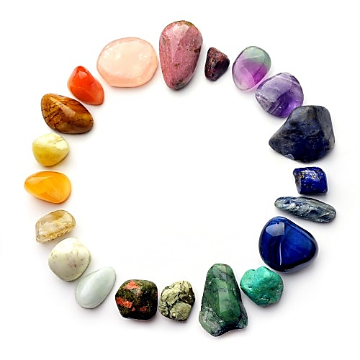
Welcome to our Crystal Keeper Learner class
Thank you so much for entering the class, its my pleasure to teach you about the amazing world of crystals!

Slide 2
You will need:
Any crystals* (even your whole crystal collection)
A pen and pencil
*During the class, if you do have the certain crystals in that part, please bring it out so you can have a meditation with it so you can put that in the final paper you will turn in via email
My email:
adriancrystalpower14@gmail.com

Slide 3
The whole class is going to teach you the methaphysical properties of the crystals and how you can use them to help you raise your vibration!
If there is time in a specific “crystal part” (a slide talking about a crystal) I will give you a 3 minute meditation on that crystal. All you have to do is hold the crystal (or look at the picture) and write down what you get from the meditation. I will also ask questions during the class, so please write down any important part of a crystal property.

Slide 4
So, What is a crystal?
A crystal or crystalline solid is a solid material whose constituents, such as atoms, molecules or ions, are arranged in a highly ordered microscopic structure, forming a crystal lattice that extends in all directions. In addition, macroscopic single crystals are usually identifiable by their geometrical shape, consisting of flat faces with specific, characteristic orientations.
The scientific study of crystals and crystal formation is known as crystallography. The process of crystal formation via mechanisms of crystal growth is called crystallization or solidification. The word crystal is derived from the Ancient Greek word κρύσταλλος (krustallos), meaning both “ice” and “rock crystal”

Slide 5
Properties of Crystals
We will be talking about many crystals during the class…

Slide 6
Clear Quartz
Clear Quartz is one of the most abundant mineral in the world. It is also considered the master healer because it amplifies any energy, acts or substitute any crystal with a specific intention. Quartz has a trigonal system and grows naturally into a point with 6 sides on the apex and the base. Clear Quartz can help amplify any energy (both positive and negative), so don’t put any quartz based crystals in front of your computer because it will amplify the EMF that the computers are producing. Quartz is used in modern technology and clocks because it keeps the energy moving. We will talk about that later on!
ON the next few slides I will show you some pictures of quartz and will be asking questions!

Slide 7
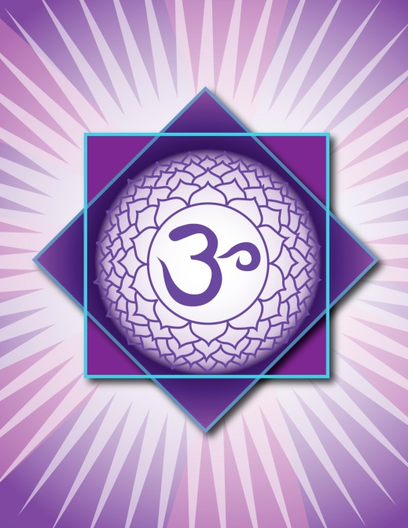
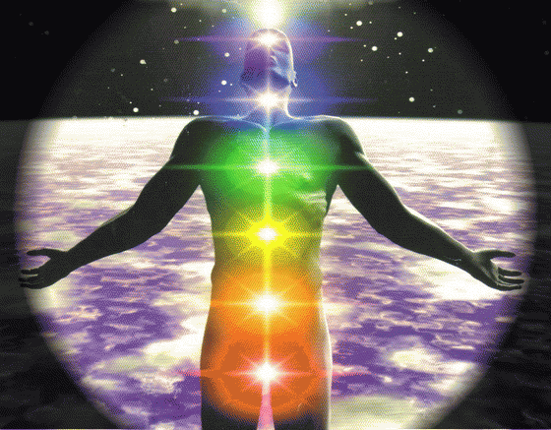
Clear Quartz
Resonates with all the chakras especially the Crown (7th) Chakra

Slide 8
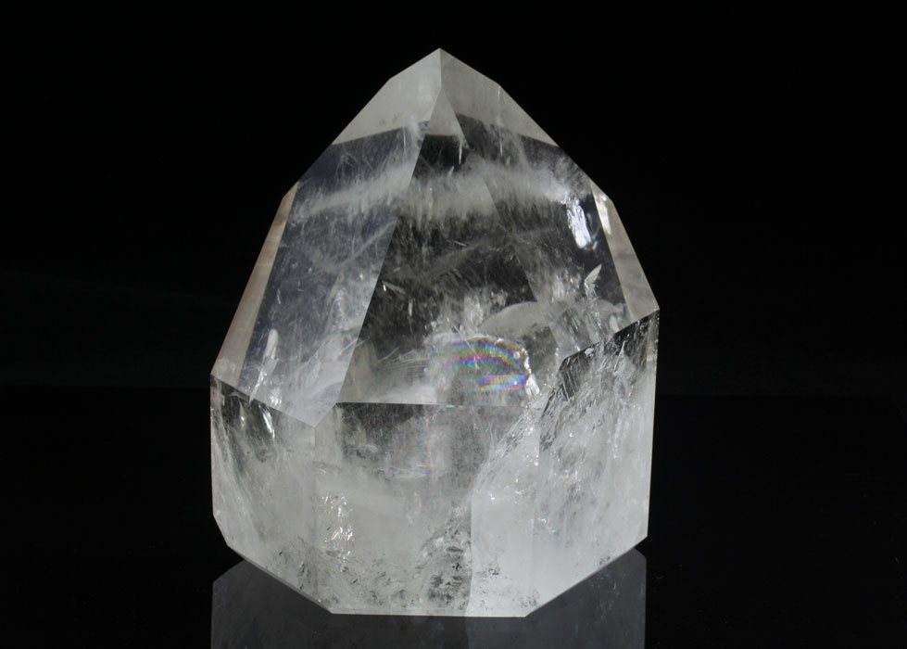
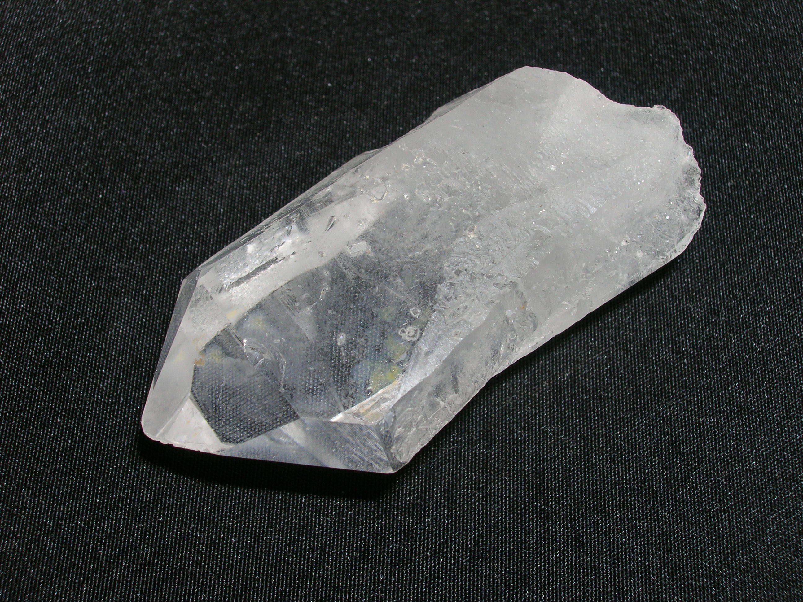

Slide 9
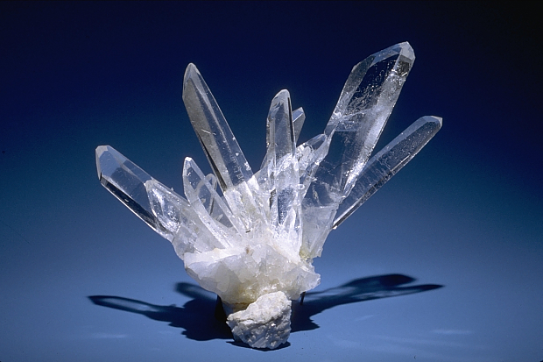
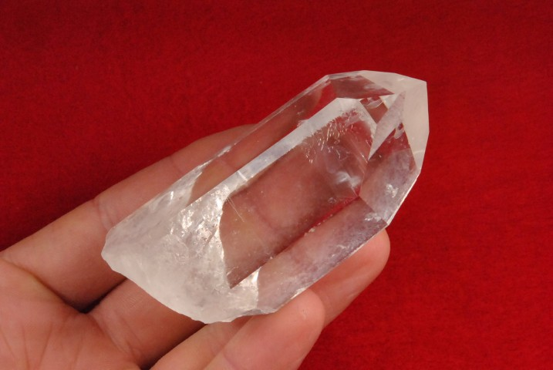

Slide 10
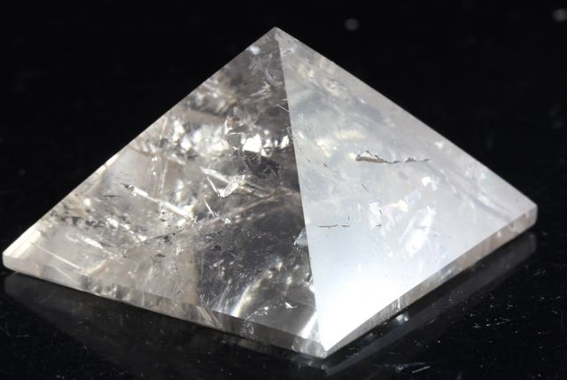
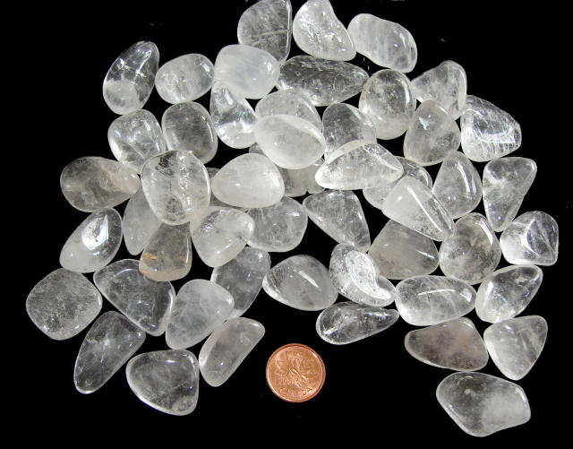

Slide 11
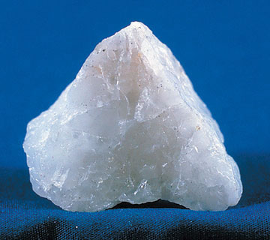
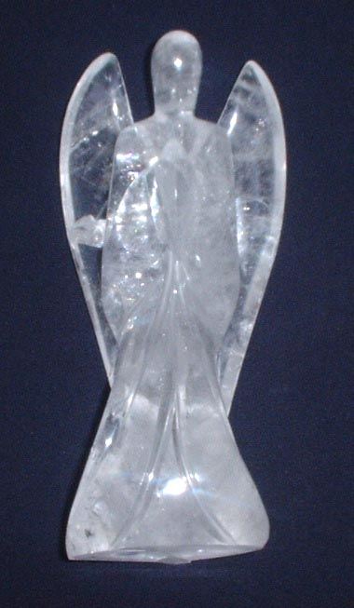

Slide 12
Amethyst
Amethyst is a violet variety of quartz often used in jewelry. The name comes from the Ancient Greek ἀ a- ("not") and μέθυστος methustos ("intoxicated"), a reference to the belief that the stone protected its owner from drunkenness.
The ancient Greeks wore amethyst and made drinking vessels decorated with it in the belief that it would prevent intoxication. It is one of several forms of quartz. Amethyst is a semiprecious stone and is the traditional birthstone for February.
Amethyst is a purple variety of quartz (SiO₂) and owes its violet color to irradiation, iron impurities (in some cases in conjunction with transition element impurities, like Manganese), and the presence of trace elements, which result in complex crystal lattice substitutions.

Slide 13
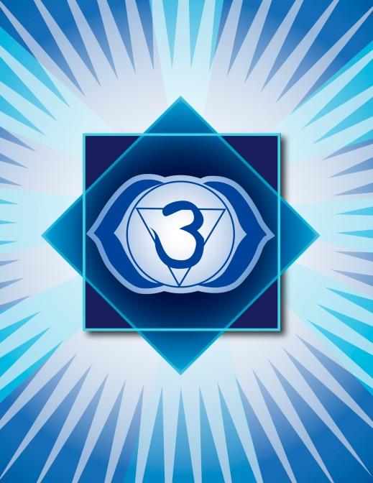
Amethyst resonates with the Crown (7th) and Third- Eye (6^{th)} Chakra

Slide 14
Question time!
1. What causes Amethyst to be purple?
2. What chakra does Amethyst correspond?
3. What is Amethyst’s hardness?

Slide 15
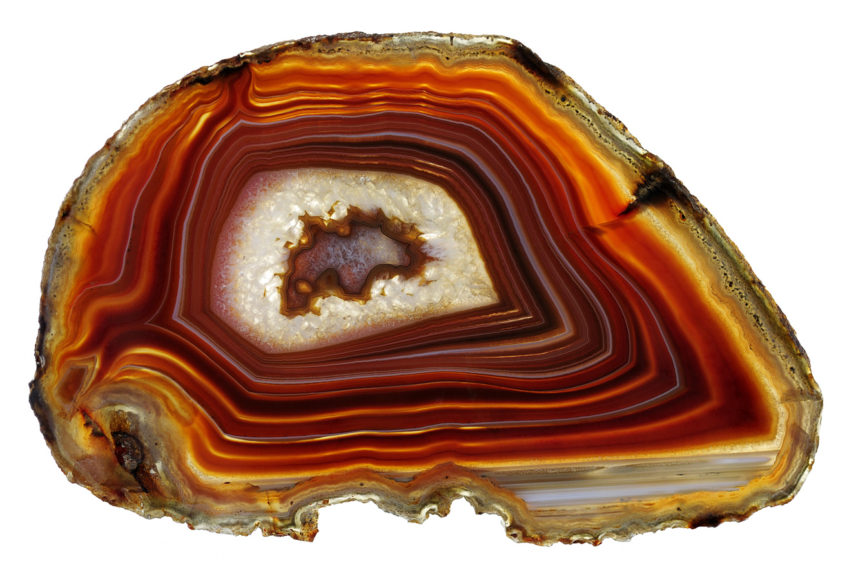
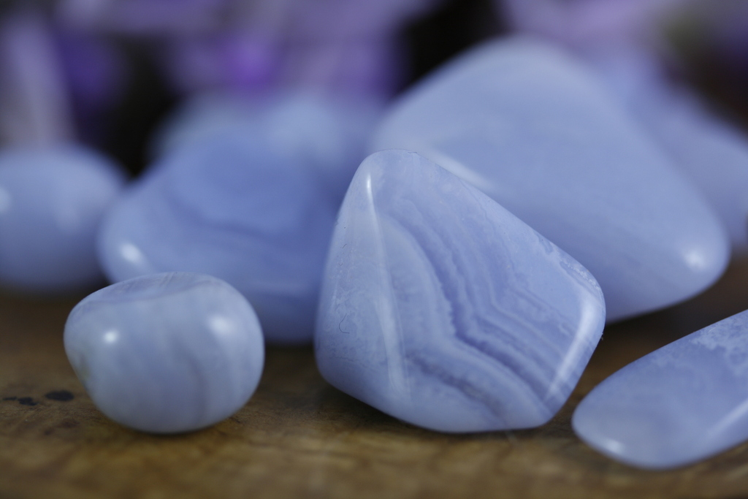
Agate
Agate is great for protection, balancing the Yin and Yang energy and is great for creativity and self esteem
Chakras: Vary by color

Slide 16
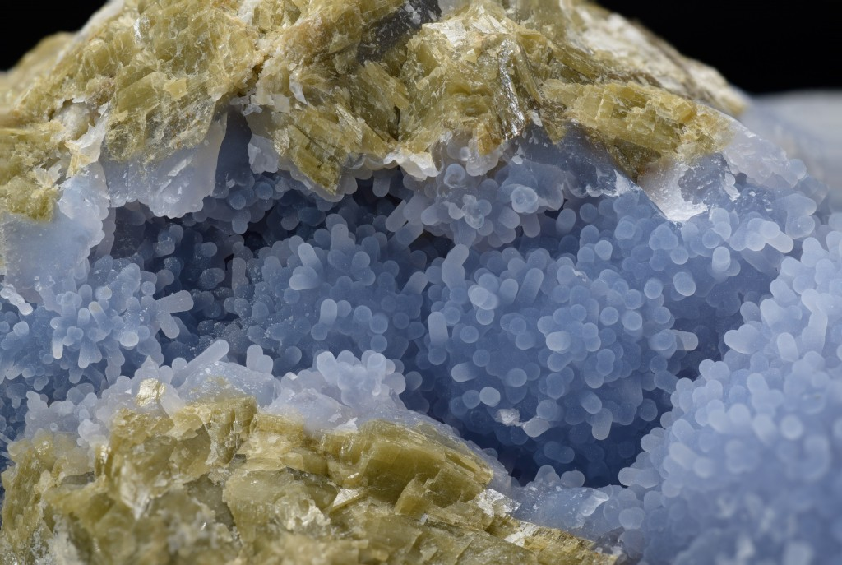
Chalcedony
Blue chalcedony is a stone with a gentle energy that feels kind of dreamy. It is said to foster balance between mind, body and spirit. It is a stone of calm and peace that is reputed to reduce or negate hostility, anger, and irritation

Slide 17
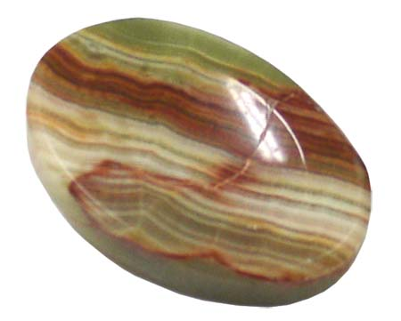
Onyx
A stone of strength and creativity. Helps balance masculine energy.

Slide 18
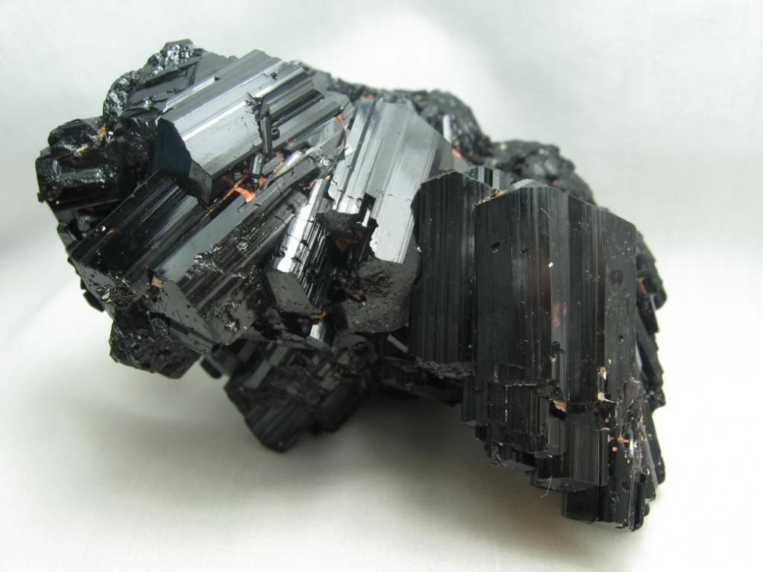
Black Tourmaline
A stone of grounding and protection. Helps a person connect back to mother earth

Slide 19
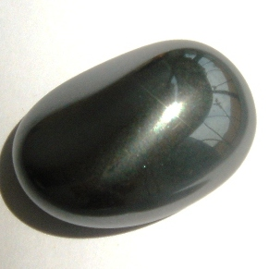
Hematite
A stone of grounding, protection, helps someone fully ground and balance the body

Slide 20
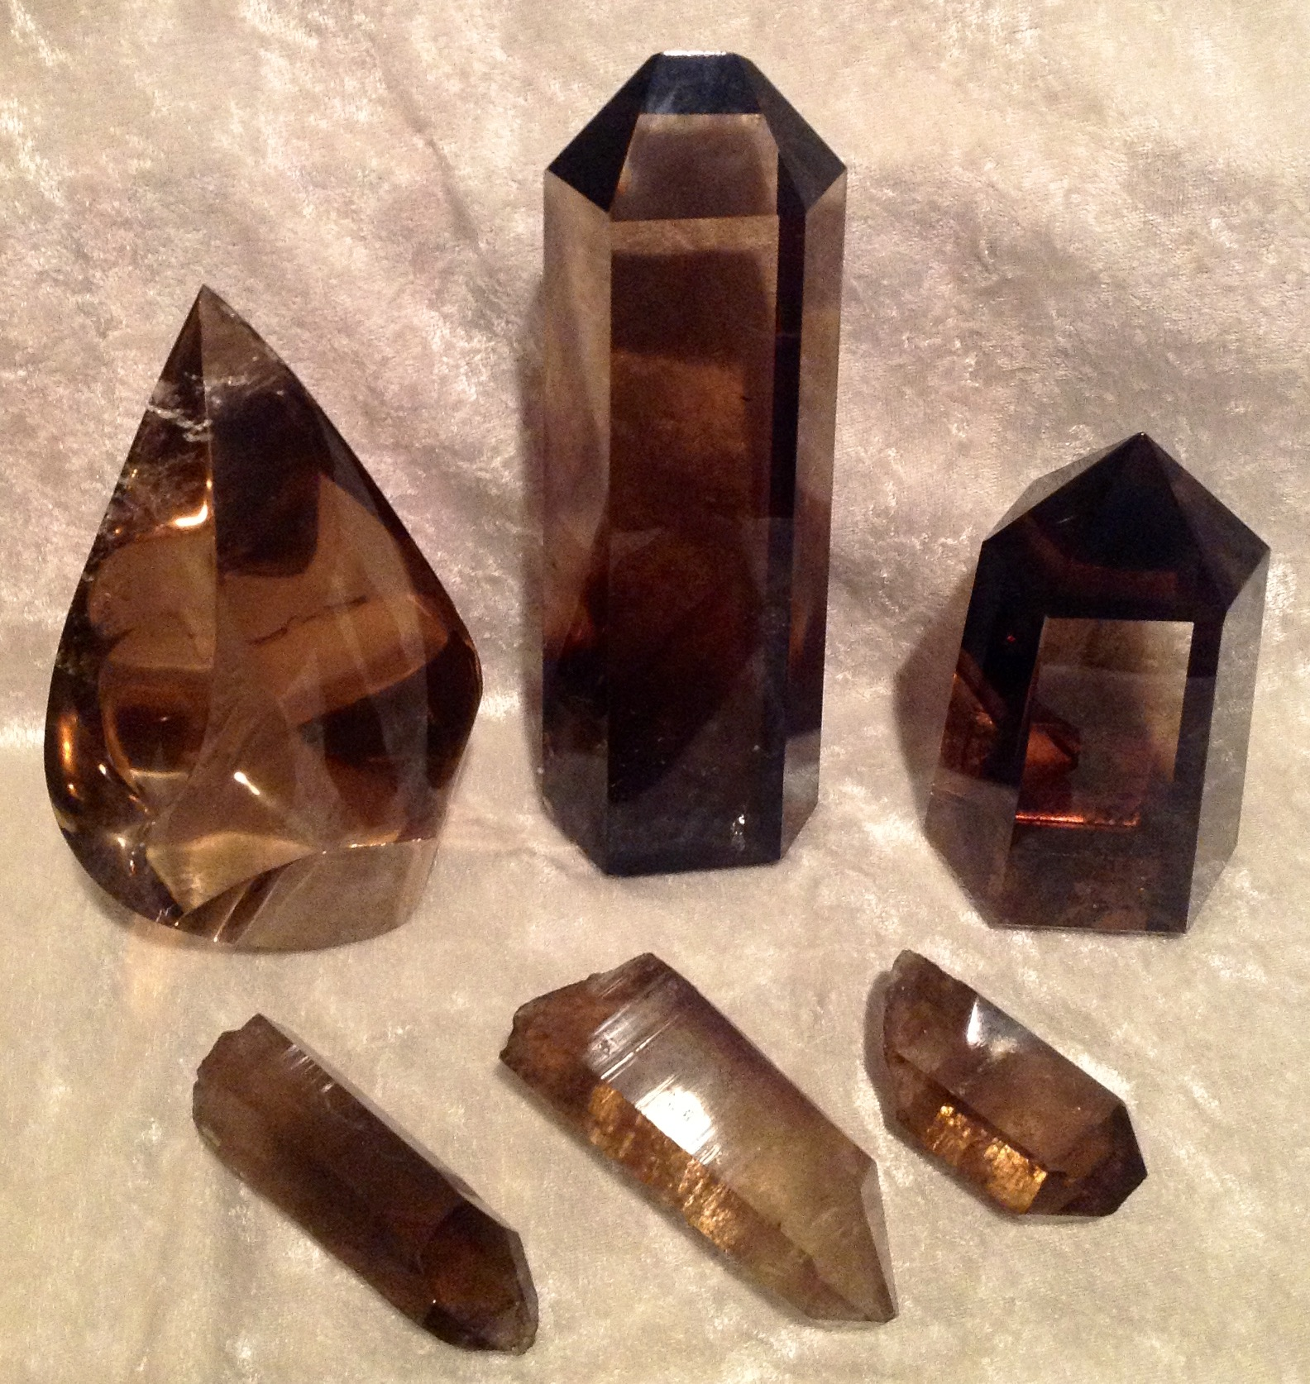
Smokey Quartz
A stone of grounding and amplification, resonates with the root and earth star chakra. Also good for grounding

Slide 21
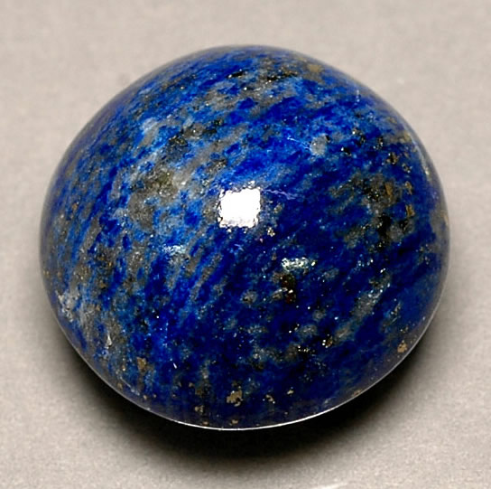
Lapis Lazuli
A stone of the goddess. Symbolize strength and loyalty. 3rd eye chakra stone

Slide 22
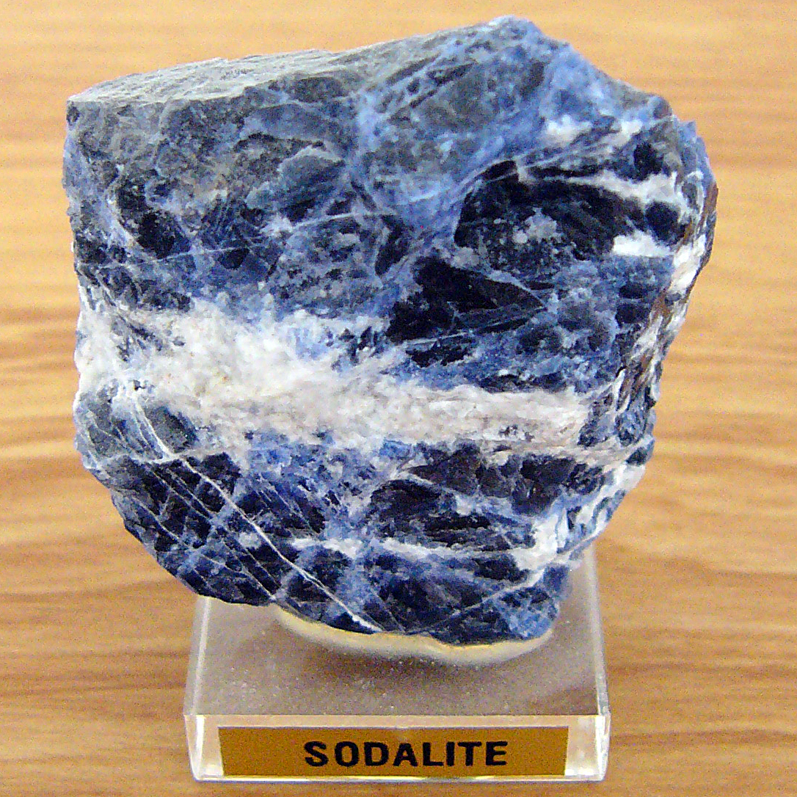
Sodalite
A stone of communication, helps someone speak calmly and gently.

Slide 23
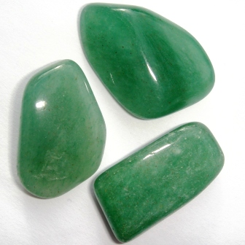
Green Aventurine
Stone of luck and prosperity. Helps calm the heart chakra

Slide 24
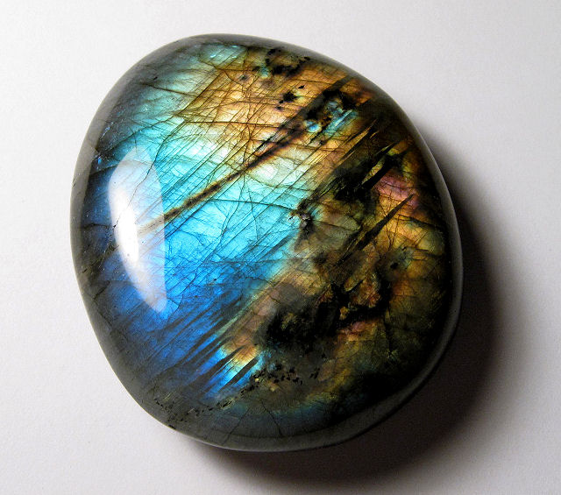
Labradorite
Stone of magick and intuition. Helps connect to divine and ancestral energy

Slide 25
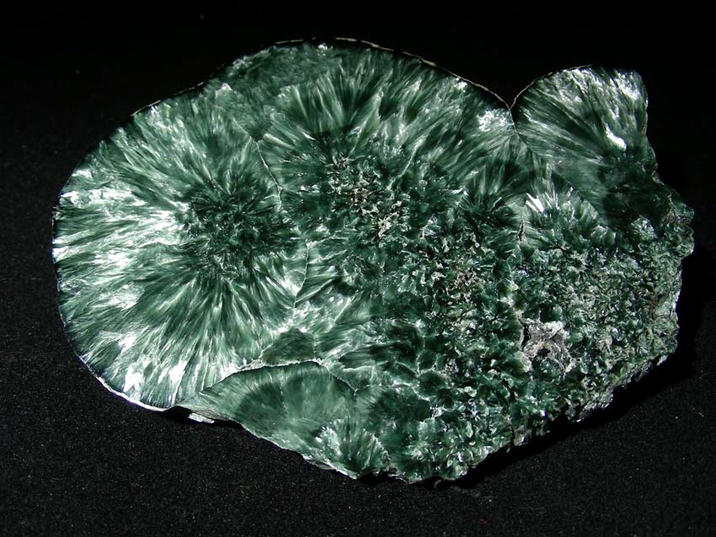
Seraphinite
Stone of the seraphims. Connects with the angelic realm

Slide 26
Please feel free to message me if you want to know about a specific crystal! ~Adrian adriancrystalpower14@gmail.com

